Slide 1
Smart Tennis Racquet Design Review
Anubhav Agarwal, Shez Malik, Robert Nelson, Lycia Tran, Rajan Vivek
Faculty Advisor: Dr. David Anderson

Slide 2
Overview
Review of Project Description and Goals
Physical Product Design
Software Design Architecture
User Interface Architecture
Current Status
Notes:
Lycia

Slide 3
Project Goals Review
Our goal is to increase access to high quality tennis analysis.
Create a device that attaches to any tennis racquet that classifies and logs metrics including:
Swing Type
Swing speed
Ball impact location
Our device will classify and run analysis on-device and send data to our web app for visualization.
Notes:
Lycia

Slide 4
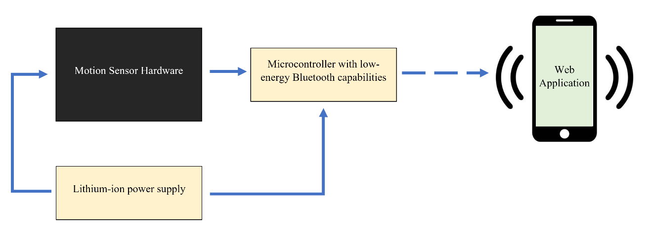
System Design Review
Notes:
Shez
tennis racket stuffs

Slide 5
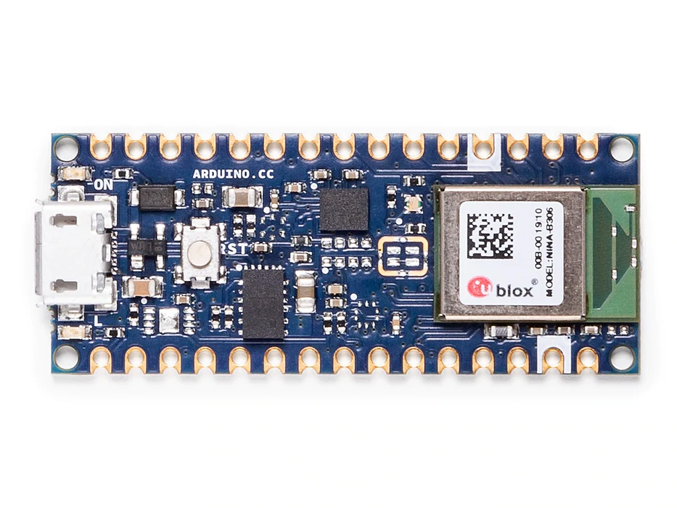
Physical Product Design
Hardware Stack
Arduino Nano 33 BLE
LiCB CR2032 3V Lithium Battery
Arduino Nano Data Logger Shield
Analog Devices 200g accelerometer
1.6kHz maximum sampling frequency
Laptop computer
Hardware Assembly
Protoboard
3D printed case designed to fit in Wilson Adult Tennis Racket
Notes:
Lycia

Slide 6
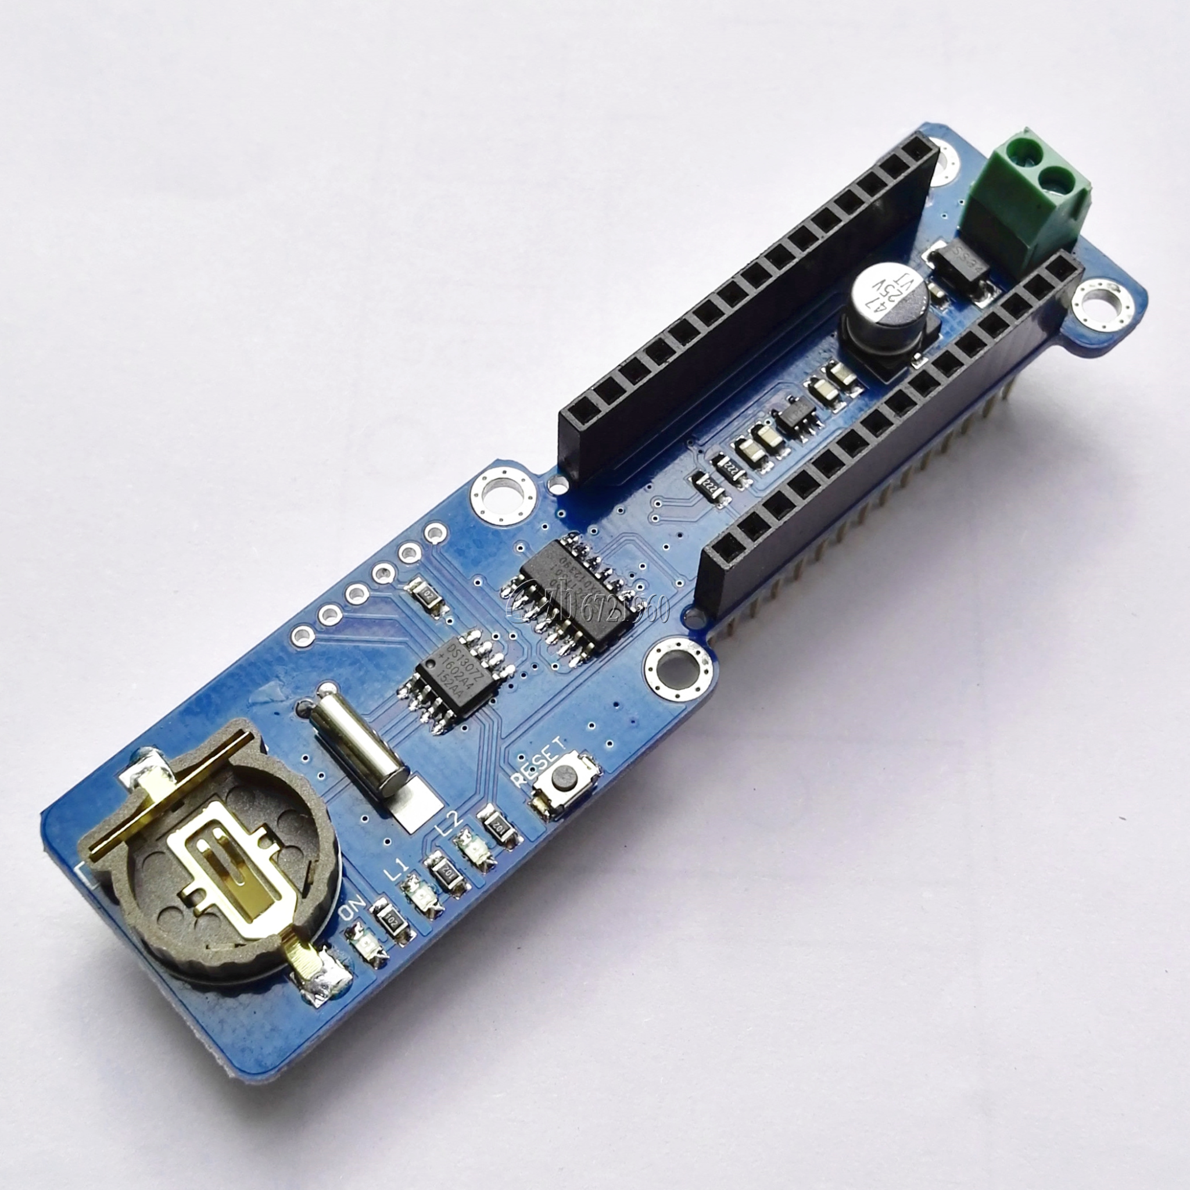
Physical Product Design
Hardware Strategy
Record data for fixed time interval on Data Shield
Use software stack to detect and classify events
Bluetooth only used to send results
Past reliability issues found with bluetooth communications at distance
Computer must send an acknowledgment of receipt
Display results on web application
Notes:
Lycia

Slide 7
Software Design: Training Data Collection
Data Collection
Various kinds of swings in real game-play
Multiple people with different skill levels
Perhaps have an additional class for Other/Bad form swings
Ground Truth of swing speeds
Baseball radar gun
Ground Truth of location of ball collision
Divide into 4 quadrants + center (sweet spot)
Metrics
3 acceleration axes and 3 gyroscope axes
2 scales: 16 G and 200 G
Notes:
Rajan

Slide 8
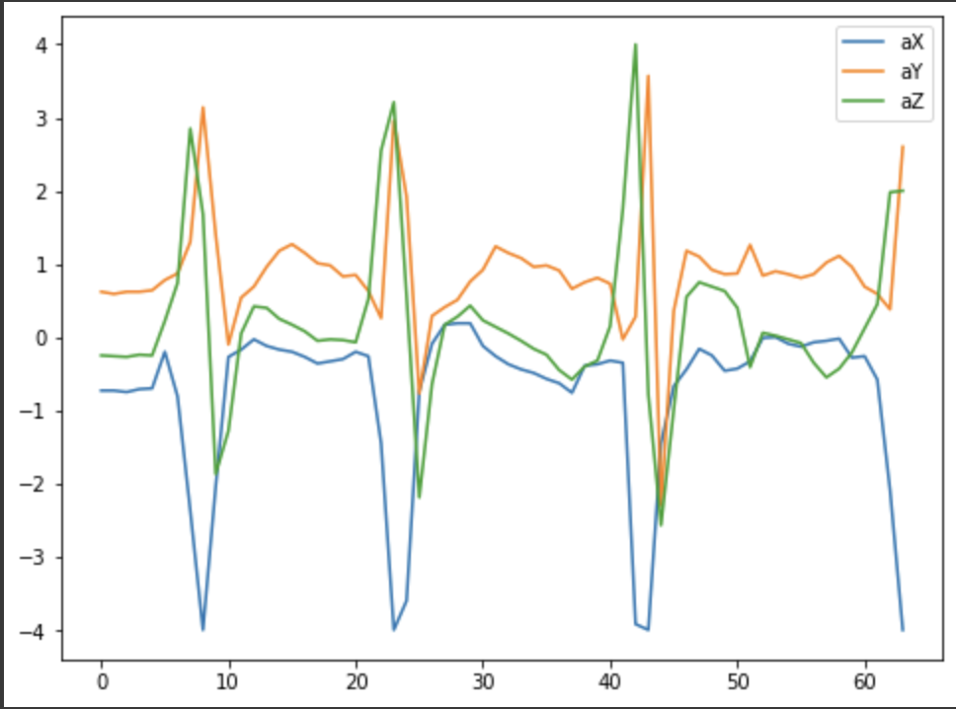
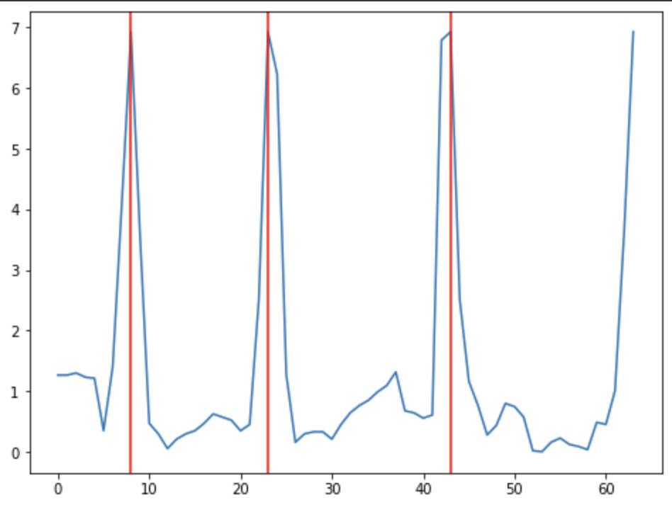
On-Chip Software Architecture Design
Event detection
Sum of squares taken for X, Y, and Z acceleration values
Threshold detection
Data taken from a fixed time before threshold event
Notes:
Lycia

Slide 9
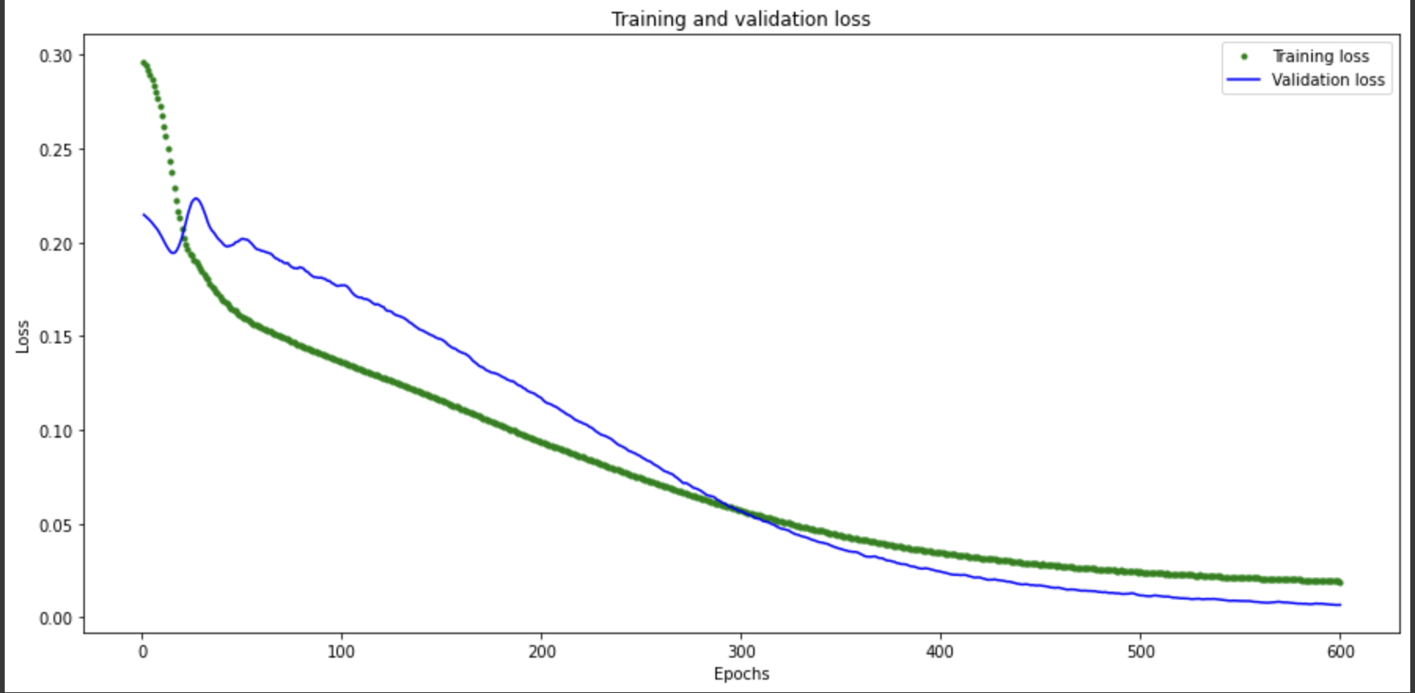
On-Chip Software Architecture Design
Swing Detection
2 Layer Neural Network
1st layer: 20 neurons
2nd layer: 15 neurons
Mean and STD of acceleration and gyroscopic sensors (3 axes each)
Prediction
Serve
Forehand
Backhand
Ground truth
User observation (swing type)
Radar gun (serve speed)
Notes:
Lycia

Slide 10
User Interface
Initial user interface site is located at https://anubop.github.io/tennis-sensor/
Anubhav and Lycia have begun development on their user branches
Notes:
Robby

Slide 11
Project Information Website
Initial information and presentation site is located at http://eceseniordesign2022spring.ece.gatech.edu/sd22p36/
Will update with presentations, technical reviews, etc.
Notes:
Robby

Slide 12
Current Status
Data Logger still hasn’t arrived
Start anyways on new accelerometer integration
Record with a long USB cable
Help verify software infrastructure with higher sampling rate
Record new data once data logger comes
Project information and user interface sites have been created
Software goals achieved thus far via 2 layer neural network
Plan to collect shot speed data using radar gun and train new model
Notes:
Robby

Slide 13
Questions?
Notes:
Shez

